Slide 1
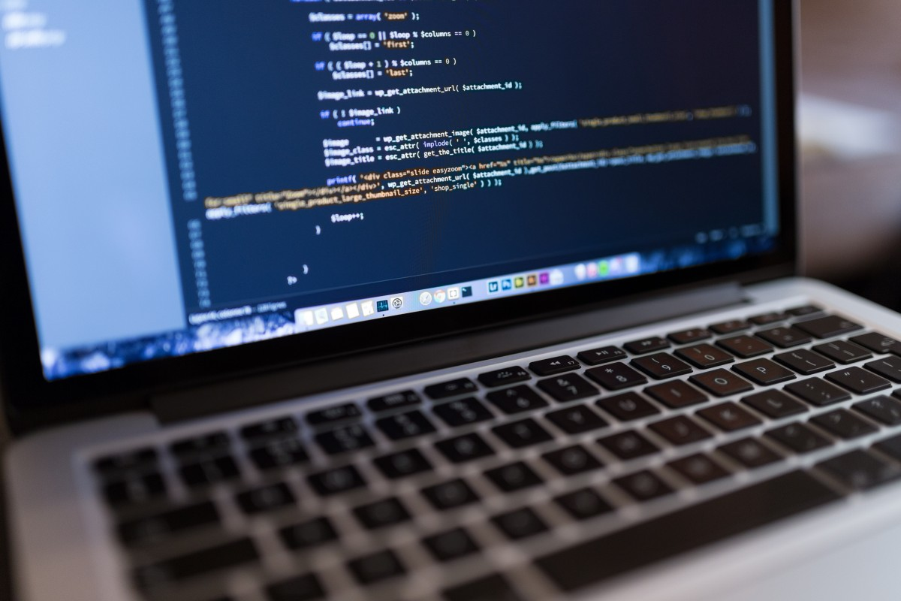
NEXTHIKE IT SOLUTIONS
Python based Calculator GUI

Slide 2
Introduction
What is Tkinter?
Tkinter is Python's standard GUI (Graphical User Interface) package.
It is a thin object-oriented layer on top of Tcl/Tk.
Purpose of the Project
Creating a simple calculator application with a GUI.
Project Requirements
Software Requirements
Python 3.x
Tkinter library (bundled with Python)
Hardware Requirements
Basic computer or laptop with Python installed

Slide 3
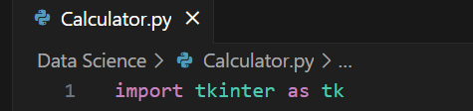
Setting Up the Environment
Install Python
Ensure Python is installed on your system. Download from .
Import Tkinter
Tkinter is included with Python. No separate installation is required.
Code Example: Importing Tkinter

Slide 4
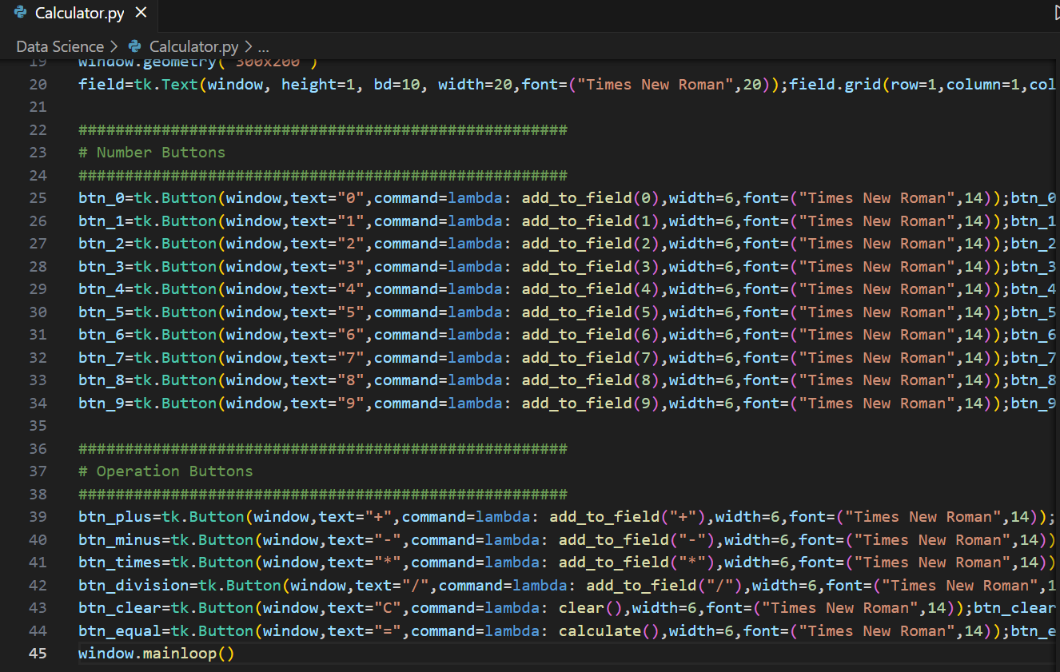
Designing the GUI
Calculator Layout
Buttons for digits 0-9
Buttons for operations: +, -, *, /
Entry widget for input and output display
Code Example: Basic Layout

Slide 5
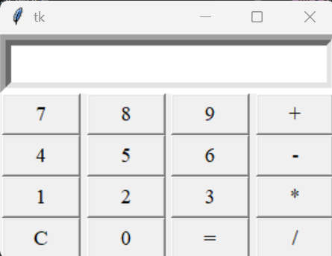
Handling Operations
Implementing Operations
Functions for addition, subtraction, multiplication, and division.
Define functions to handle button click.
Update the entry widget with the clicked value.
Add some styles to improve the visual appeal.
Adjust the size and position of buttons.

Slide 6

Conclusion
Summary
Python based Calculator built.
Tkinter library used to design the calculator.
All the normal Mathematical operations like +,-,x,/ included.
Calculator functioning as desired.

